Slide 1

Computational Husbandry
Seth Russell – seth.russell@cuanschutz.edu
Peter DeWitt – peter.dewitt@cuanschutz.edu
SOM, Dept of Biomedical Informatics
Presentations: https://github.com/magic-lantern/Computational-Husbandry-2022
Survey: https://forms.gle/ZumeuAiWRm83ra9h9
Notes:
Introductions:
Names
programming experience
Statistics or research exp2erience

Slide 2
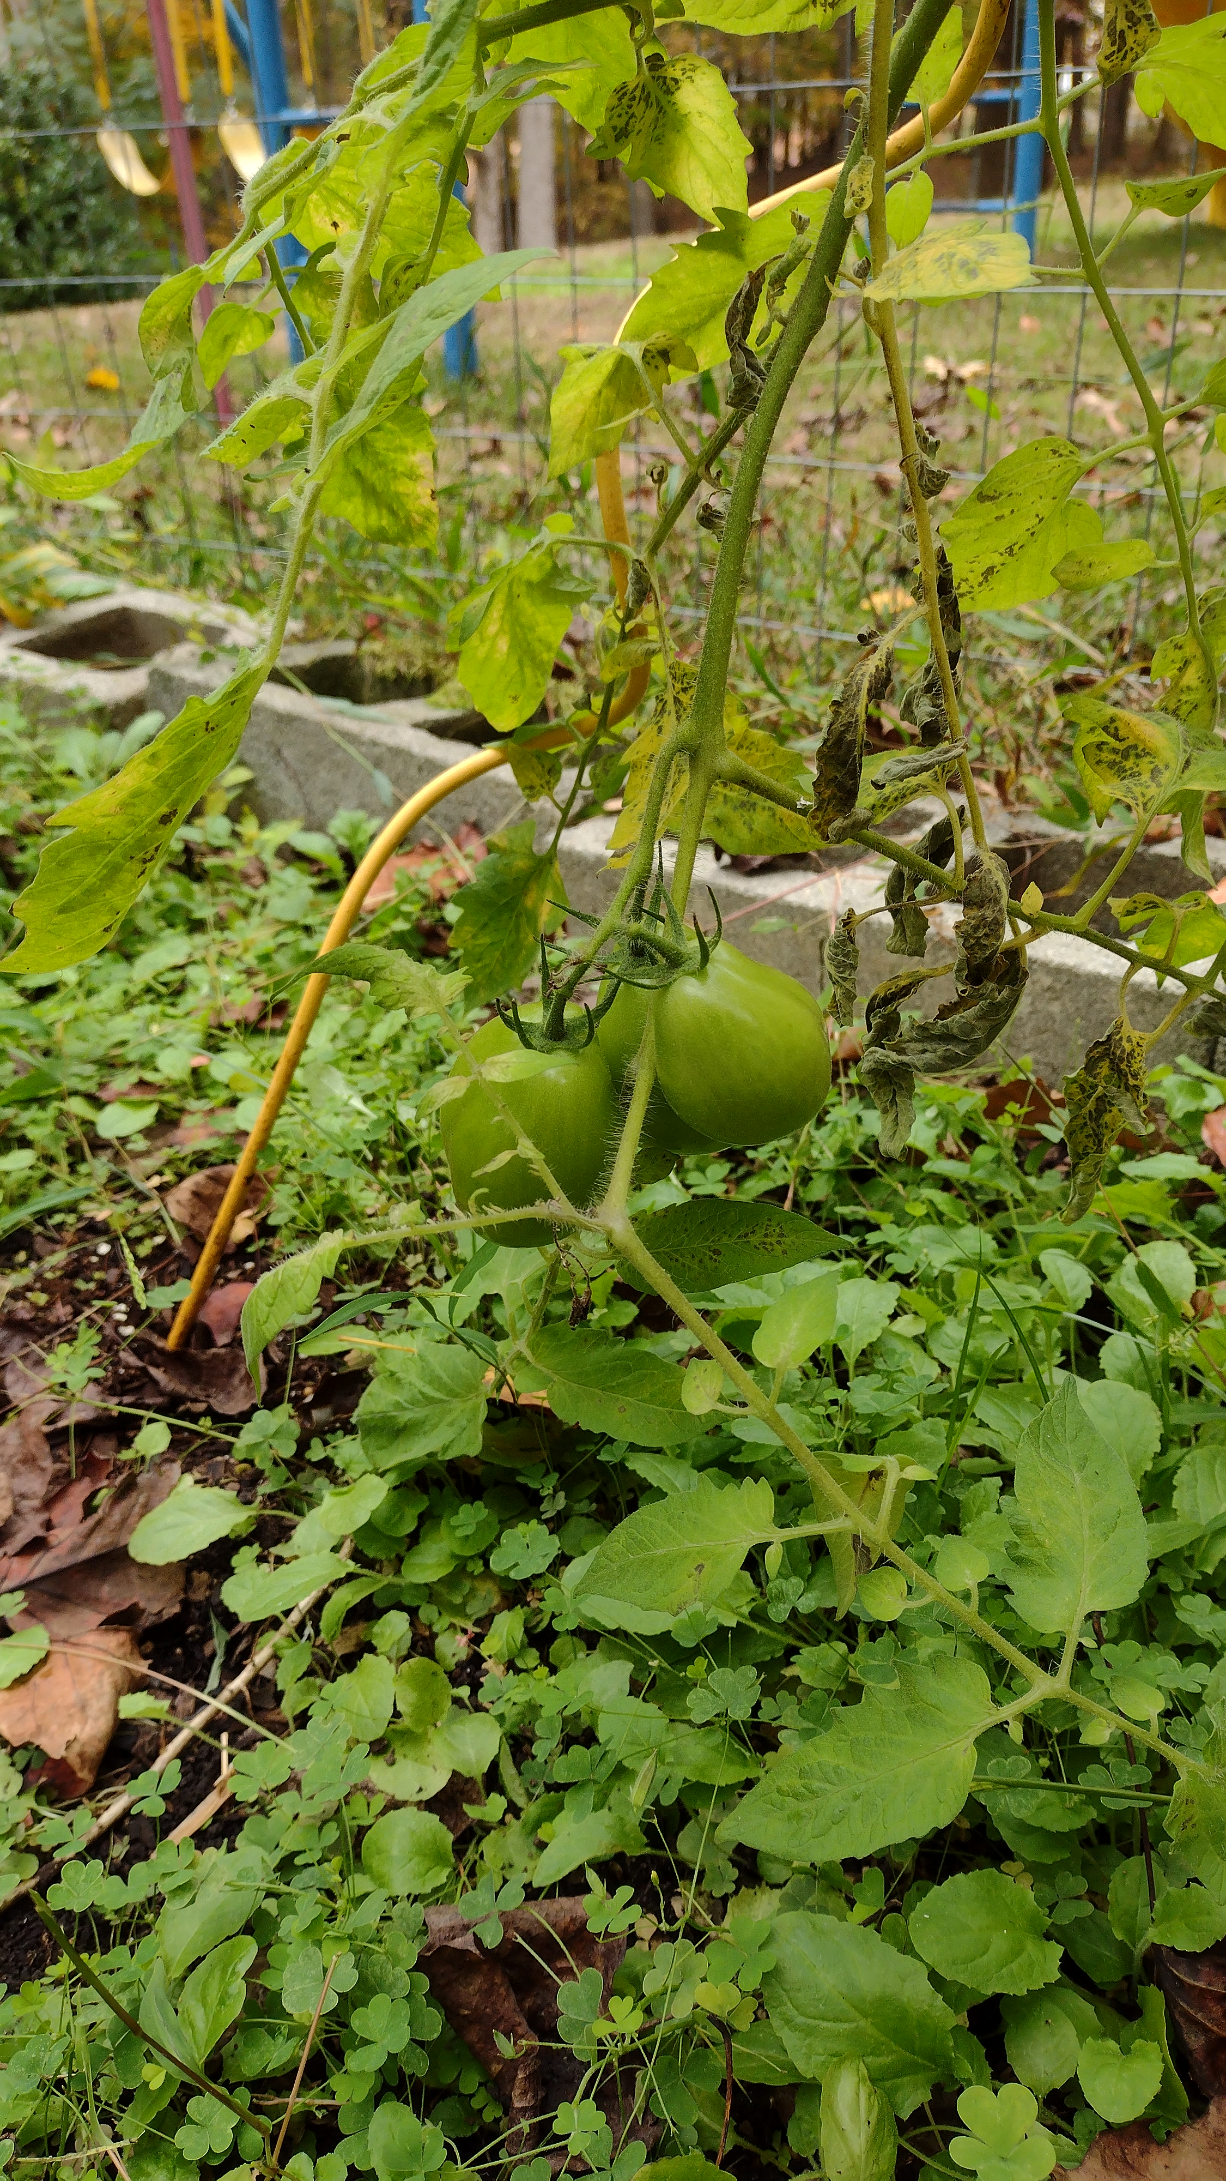
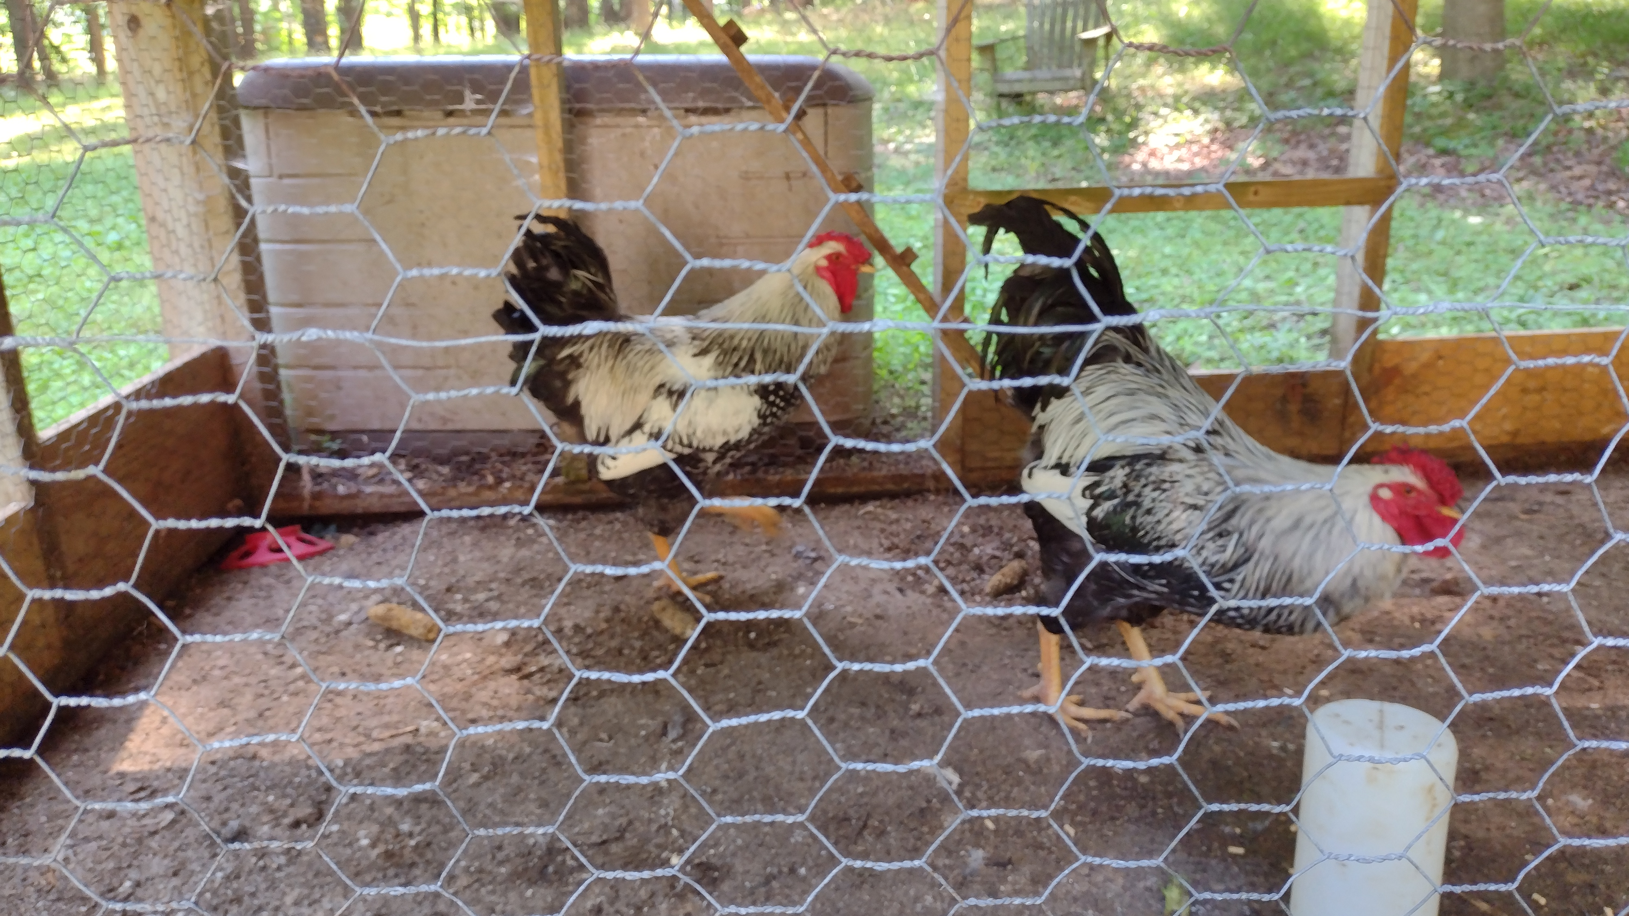
Computational Husbandry
Husbandry
Homesteading
Permaculture
Notes:
The goal of these lectures is to teach you some of the things you need to know to be good computational researchers as well as become skilled professionals that work well with others. Creating a sustainable computational environment is essential to current and future success.
Opposite these terms are things such as strip mining, single crop farming, or slash and burn practices at massive scale.
Growing and raising crops or animals is known as “husbandry” Computational husbandry takes some of the same principles and applies them to growing and harvesting computational research. At times the relationship may be an adversarial one similar to raising roosters

Slide 3
Computing Resources
CPU – Central Processing Unit
RAM – Random Access Memory
Persistent Storage – Hard Disk, Solid State Drive
GPU – Graphics Processing Unit
Network – Communication to other machines (storage, data, programs, etc).
Software
Data

Slide 4
Computing Resources
The Operating System is the main program controlling access to and allocation of these resources. All of these are shared by all users and running programs on a system.
The slowest/most limited resource involved controls the maximum throughput of the system.
Networking interfaces allow the sharing of all computing resources among many people and many programs.
Network computing increases the complexity of software development

Slide 5
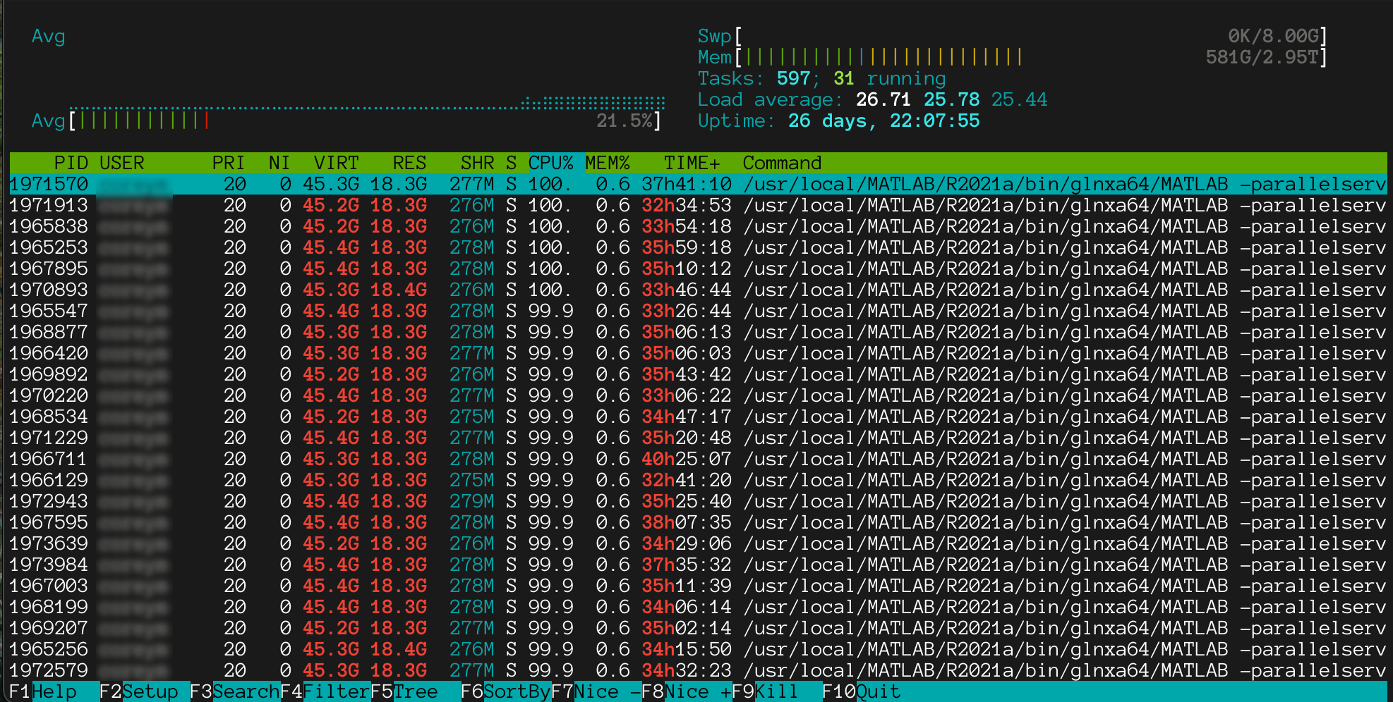
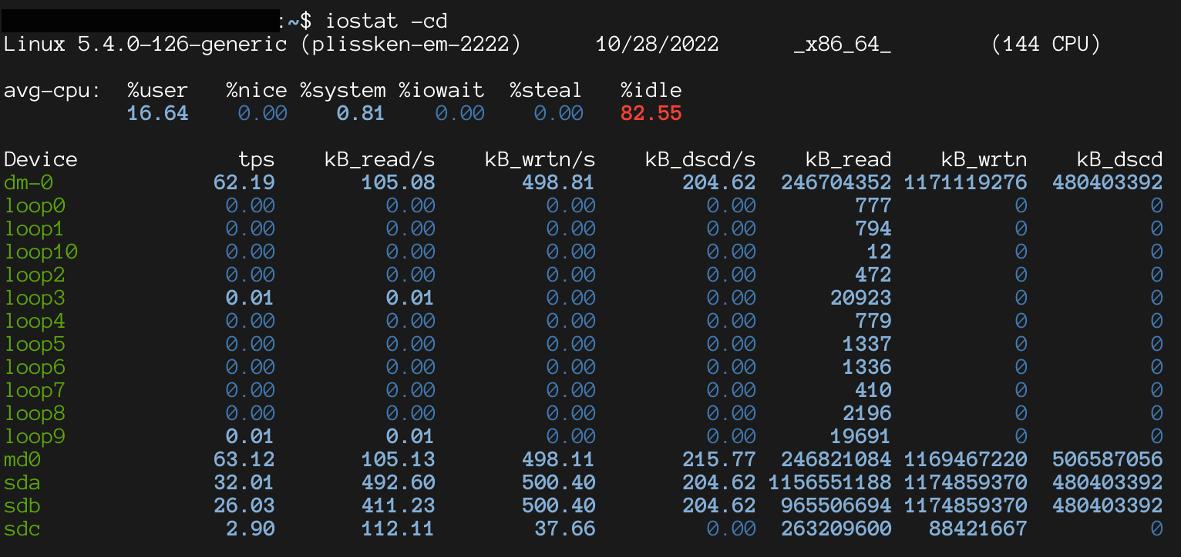
Measure twice, cut once
Notes:
Knowing what resources are available and how they are being used is an important part of computational husbandry. Linux and other Unix-like operating systems have tools such as htop or top as shown here that allow you to see in near real-time CPU and memory usage.
iostat shows disk and network usage
Before you begin a large computational job, make sure you have enough resources available. If you don’t know what resources are required, either figure it out first or carefully watch your job as it runs.

Slide 6
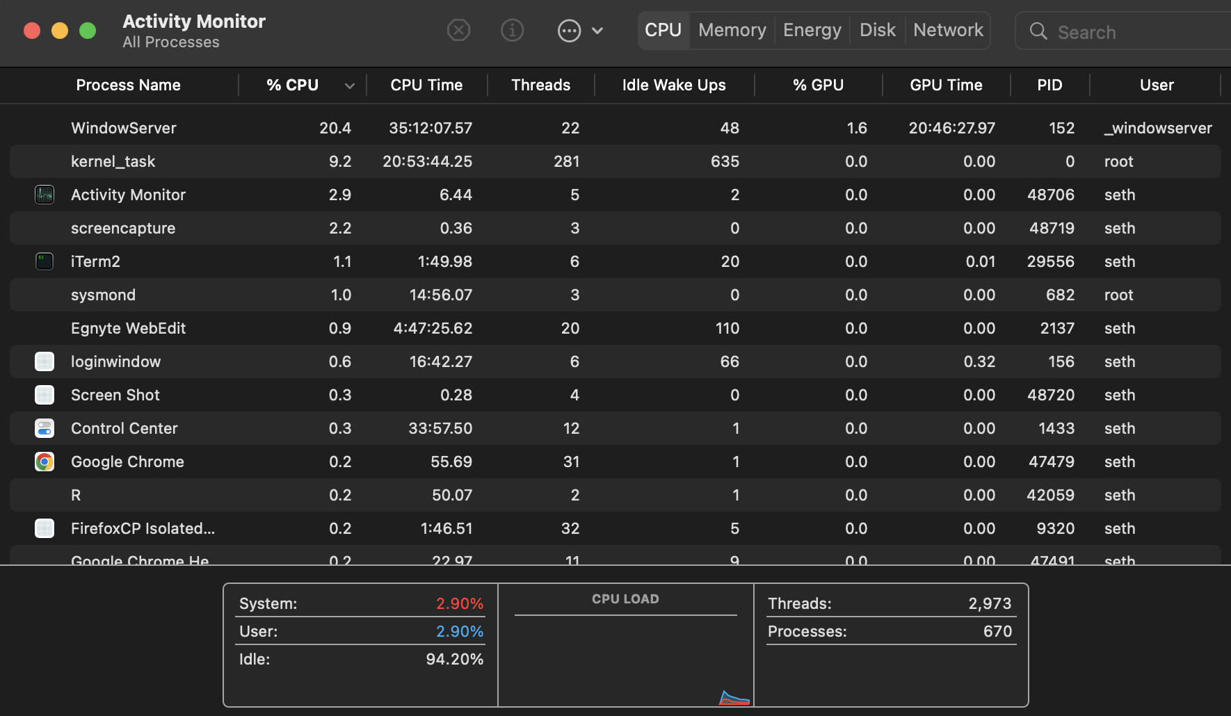
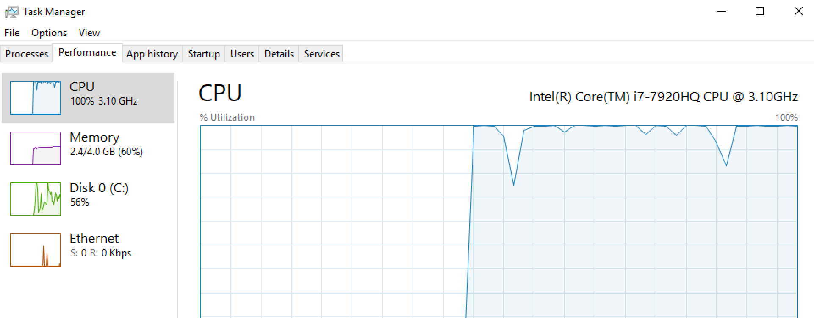
Measure twice, cut once
Notes:
macOS has “Activity Monitor” and Windows has “Task Manager”

Slide 7
Computer Hardware vs the Human Brain
Notes:
Computer hardware is very complex. Operating Systems and the software we use on a daily basis are also very complex. Although much testing and effort goes into verifying software we use is correct and accurate, sometimes you may see something completely unexpected.

Slide 8


Line endings – aka “I've got a blank space, baby”
MS-DOS used the two-character combination of CRLF to denote line endings in files, and modern Windows computers continue to use CRLF as their line ending to this day. Meanwhile, from its very inception, Unix used LF to denote line endings, ditching CRLF for consistency and simplicity. Apple originally used only CR for Mac Classic but eventually switched to LF for OS X, consistent with Unix. https://www.aleksandrhovhannisyan.com/blog/crlf-vs-lf-normalizing-line-endings-in-git/
macOS/Linux
Windows
Notes:
An important lesson for collaborating with others. Although a file may look identical, non-printable characters are encoded differently on different operating systems, which causes frequent problems for collaborations. Any time data is exchanged, this can be a major problem.

Slide 9
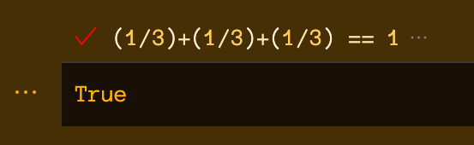
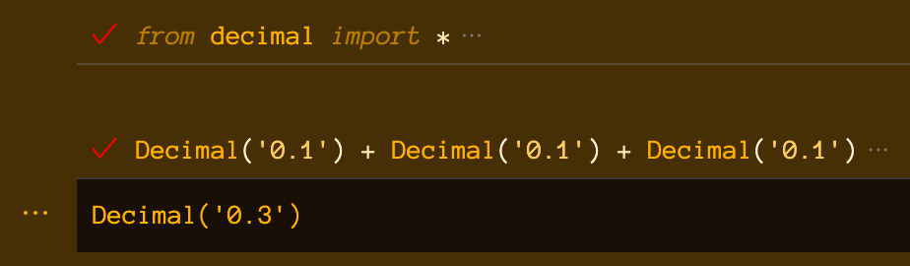
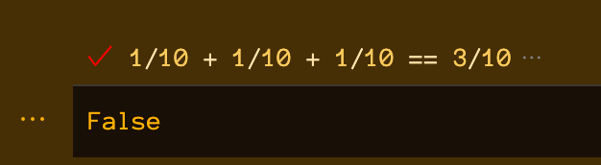
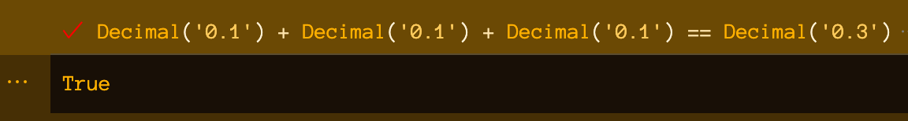
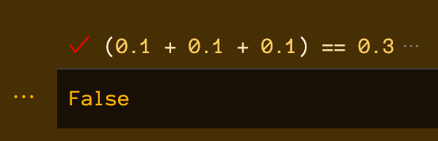
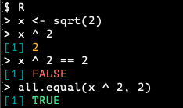
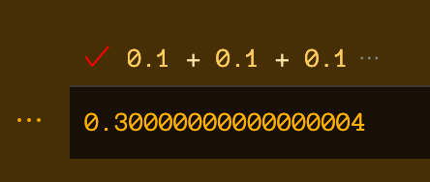
Floating point representations vs Math
Notes:
"The errors in Python float operations are inherited from the floating-point hardware, and on most machines are on the order of no more than 1 part in 2**53 per operation. That’s more than adequate for most tasks, but you do need to keep in mind that it’s not decimal arithmetic and that *every float operation* can suffer a *new* rounding error."

Slide 10
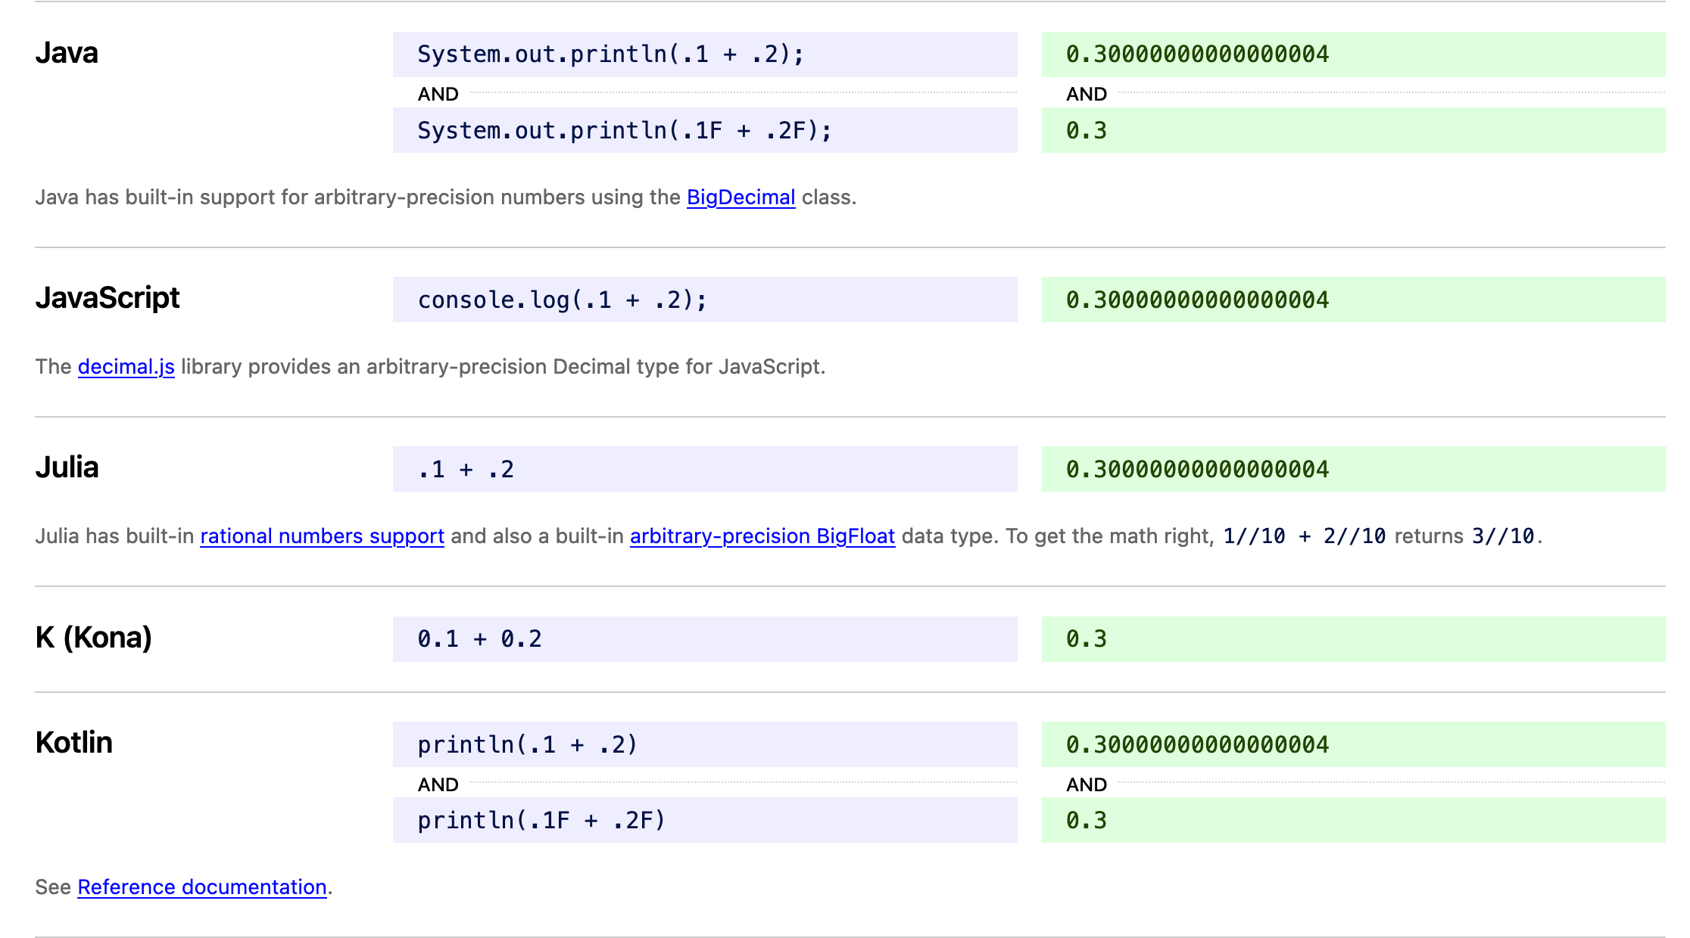
Floating point representations vs Math
https://0.30000000000000004.com/

Slide 11
Status check
https://cups.fast.ai/computationalhusbandry
Notes:
https://cups.fast.ai/computationalhusbandry
https://cups.fast.ai/computationalhusbandry/teacher

Slide 12
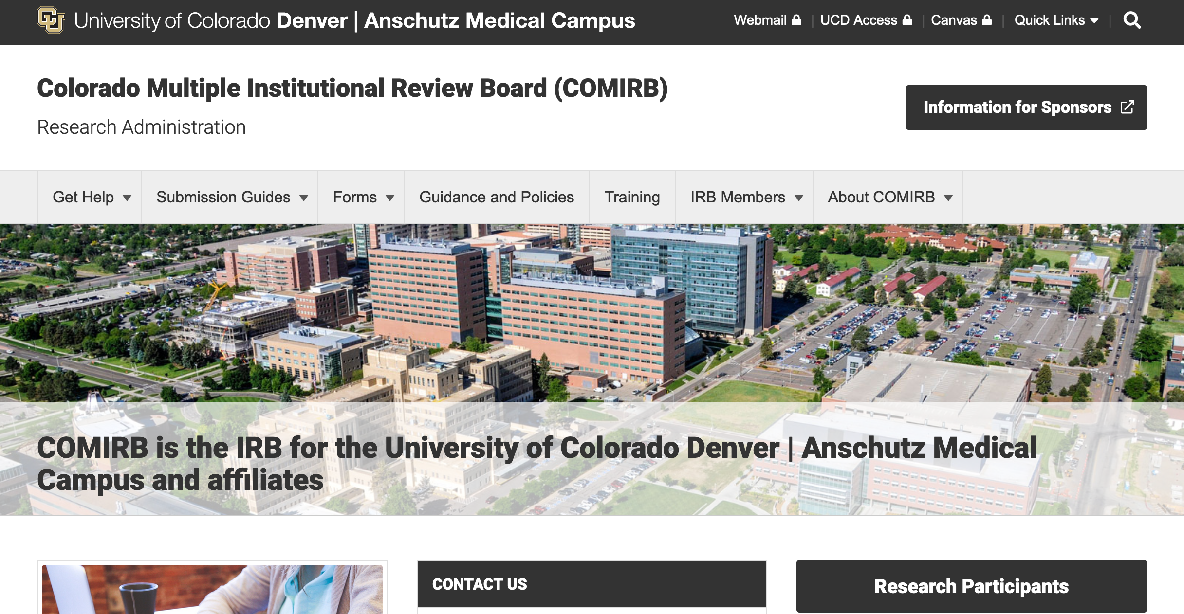
Working with health care data
Data Use Agreements
Institutional Review Boards
https://research.cuanschutz.edu/regulatory-compliance/home/hipaa/data-use-agreement
https://research.cuanschutz.edu/regulatory-compliance/home/hipaa/data-sharing
Notes:
Data Use Agreement (DUA) - is a specific type of agreement that is required under the HIPAA Privacy Rule and must be entered into before there is any use or disclosure of a Limited Data Set (defined below) from a medical record to an outside institution or party for one of the three purposes: (1) research, (2) public health, or (3) health care operations purposes. A Limited Data Set is still Protected Health Information (PHI), and for that reason, HIPAA Covered Entities or Hybrid Covered Entities like University of Colorado must enter into a DUA with any institution, organization or entity to whom it discloses or transmits a Limited Data Set.

Slide 13
Working with health care data
Health Insurance Portability and Accountability Act (HIPAA) Privacy Rule
https://www.hhs.gov/hipaa/for-professionals/privacy/special-topics/de-identification/index.html#standard
Protected health information is information, including demographic information, which relates to:
the individual’s past, present, or future physical or mental health or condition,
the provision of health care to the individual, or
the past, present, or future payment for the provision of health care to the individual…
Notes:
Healthcare data is highly protected by law

Slide 14
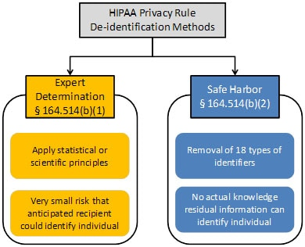
Working with health care data
Notes:
Healthcare data is highly protected by law. There are 2 main methods for de-identifying data according to federal law. In my experience working with health care data and at health care institutions, Safe Harbor method is the preferred method to follow.

Slide 15
Working with health care data
Safe Harbor method: Remove all of the following
(A) Names
(B) All geographic subdivisions smaller than a state, … except for the initial three digits of the ZIP code
(C) All elements of dates (except year) for dates that are directly related to an individual, including birth date, admission date, discharge date, death date, and all ages over 89 …
(D) Telephone numbers
(L) Vehicle identifiers and serial numbers, including license plate numbers
(E) Fax numbers
(M) Device identifiers and serial numbers
(F) Email addresses
(N) Web Universal Resource Locators (URLs)
(G) Social security numbers
(O) Internet Protocol (IP) addresses
(H) Medical record numbers
(P) Biometric identifiers, including finger and voice prints
(I) Health plan beneficiary numbers
(Q) Full-face photographs and any comparable images
(J) Account numbers
(R) Any other unique identifying number, characteristic, or code, except as permitted
(K) Certificate/license numbers
Notes:
Healthcare data is highly protected by law

Slide 16
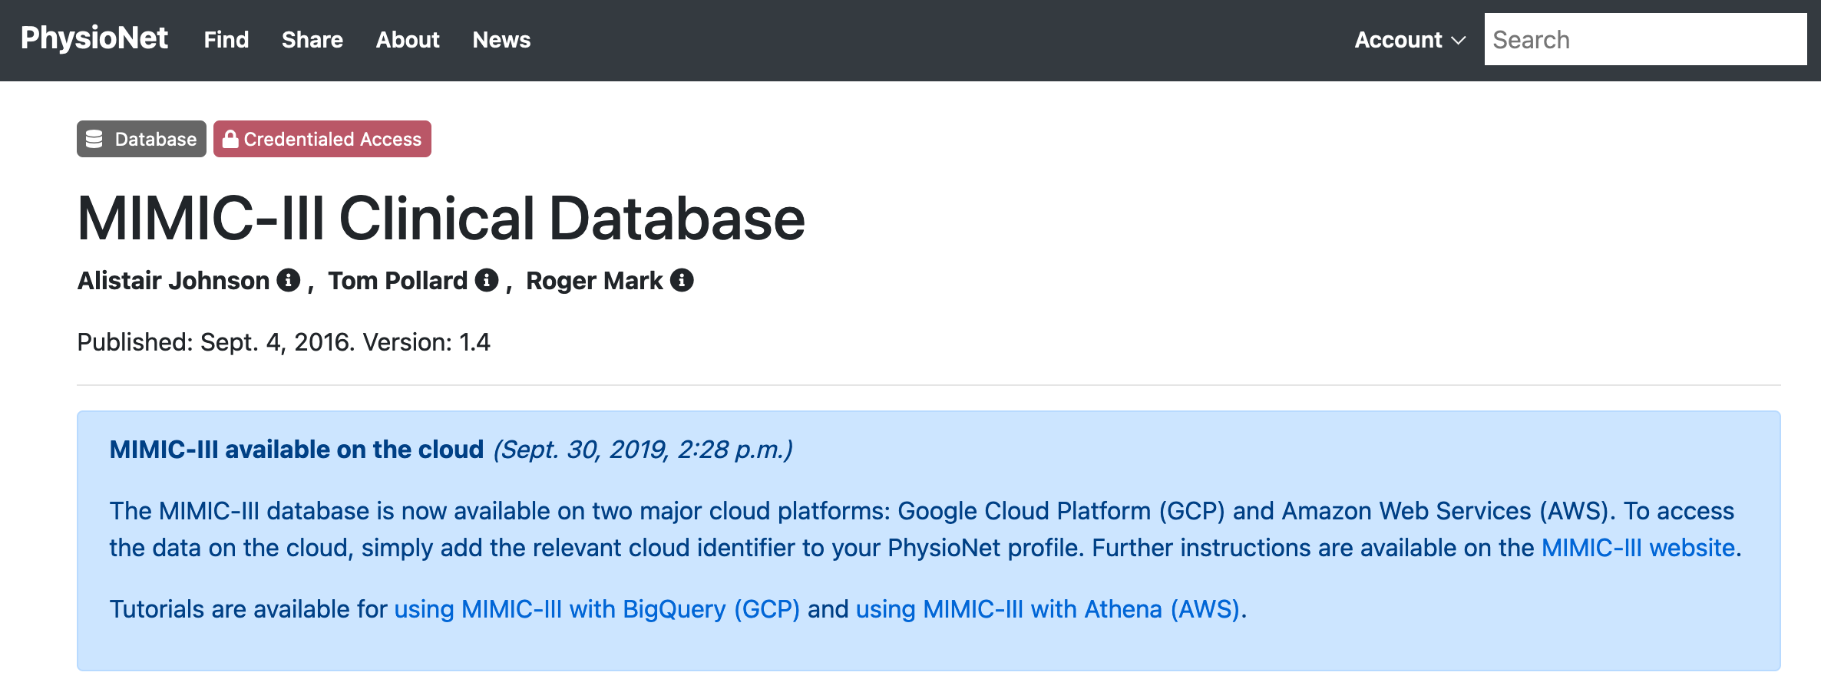
Working with health care data
Example dataset: https://physionet.org/content/mimiciii/
MIMIC-III integrates deidentified, comprehensive clinical data of patients admitted to the Beth Israel Deaconess Medical Center in Boston, Massachusetts, and makes it widely accessible to researchers internationally under a data use agreement. The open nature of the data allows clinical studies to be reproduced and improved in ways that would not otherwise be possible.
The MIMIC-III database was populated with data that had been acquired during routine hospital care, so there was no associated burden on caregivers and no interference with their workflow. Data was downloaded from several sources, including:
archives from critical care information systems.
hospital electronic health record databases.
Social Security Administration Death Master File.
Notes:
Healthcare data is highly protected by law

Slide 17
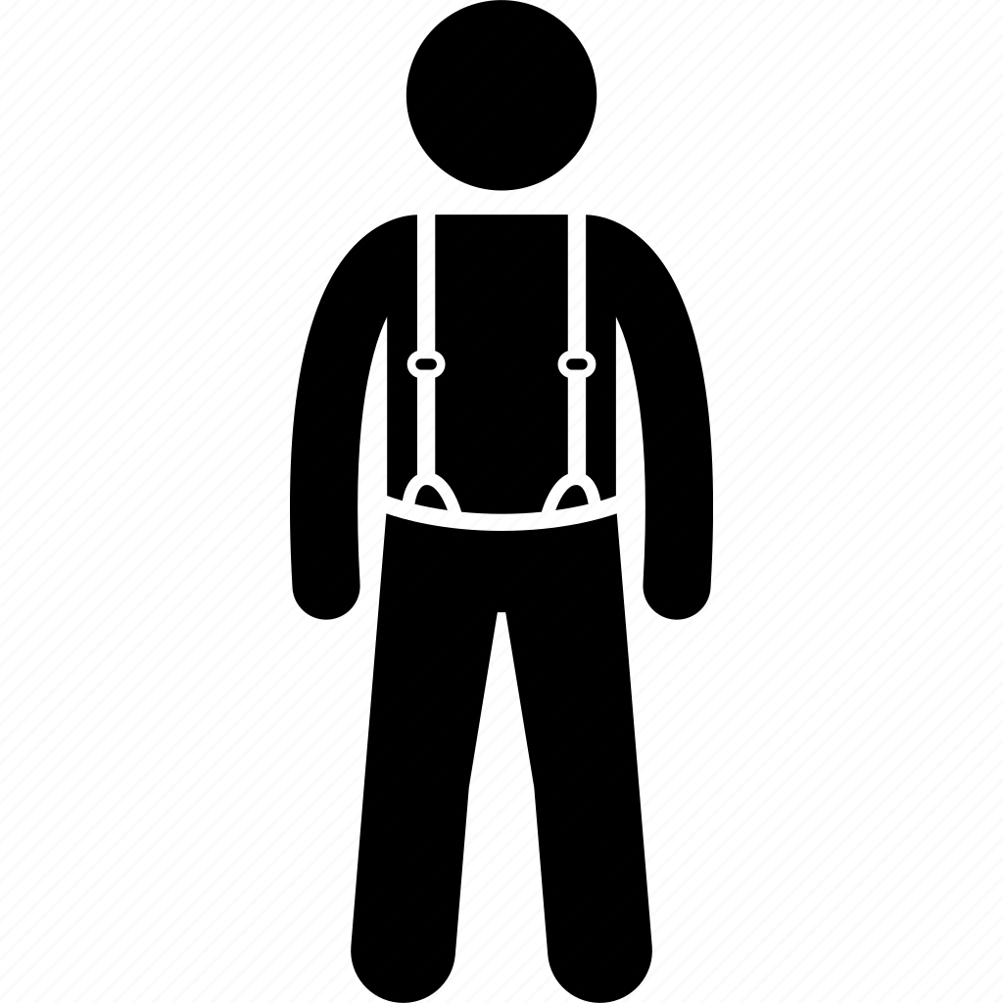
Working with Data – OS/Human Protections
OS Protections
Firewalls
Access controls
User permissions
Group permissions
Human Protections
Don’t reuse passwords
Don’t share passwords
Report problems ASAP
Don’t move data to other systems
Keep OS Software current
Run trusted software
Specific tasks are performed by specific people
Notes:
Program or operating system level controls are important.
Controls are operating system specific, but these are concepts that are in general common across most operating systems.
Software controls are insufficient however.
Ever heard the phrase “belt and suspenders”?
Securing data requires a multifaceted approach to fully solve.

Slide 18


Working with Data – Deep vs Shallow Copies
variable A = load_large_dataset()
B = A[colums 1 to 3]
C = A[columns 3 to 7]
A, B, C
A
B
C
Notes:
In shallow copies, A, B, and C are windows into the same object in memory. A gives access to all rows and columns of the large dataset. B and C are just windows that show portions of the same large dataset. As an alaolgy, imagine that A, B, and C are windows into your home. Adding more windows might not be cheap, but can be done in as little as a few hours given the right tools and skillset.
In deep copies, A, B, and C are actually separate and distinct objects in main memory. Given the pseduo code shown here, B and C do not represent a duplication of all of the original information, but given sufficiently large starting dataset A, these 3 copies could cause the use of virtual memory, or out of memory issues. Following the previous analogy, A, B, and C are all separate homes built from a similar pattern. Creating a new home is much more expensive in terms of materials, effort, and time compared to adding a new window.
When you write code like B = A or B is a subset of A, do you know what your language of choice is doing?

Slide 19
Creating code that others can understand
I'm starting with the man in the mirror
I'm asking him to change his ways
And no message could've been any clearer
If they wanna make the world a better place
Take a look at yourself and then make a change
Glen Ballard and Siedah Garrett; Performed by Michael Jackson, Bad 1987
Notes:
Writing code that others can understand is a crucial skill to computational research and computational husbandry. Also, if you’ve ever developed and maintained software over a period of time longer than a semester, you will come to learn that “others” is often just yourself separated by time.

Slide 20
Status check
Close your browser window first if you still have it open
https://cups.fast.ai/computationalhusbandry
Notes:
https://cups.fast.ai/computationalhusbandry/teacher

Slide 21
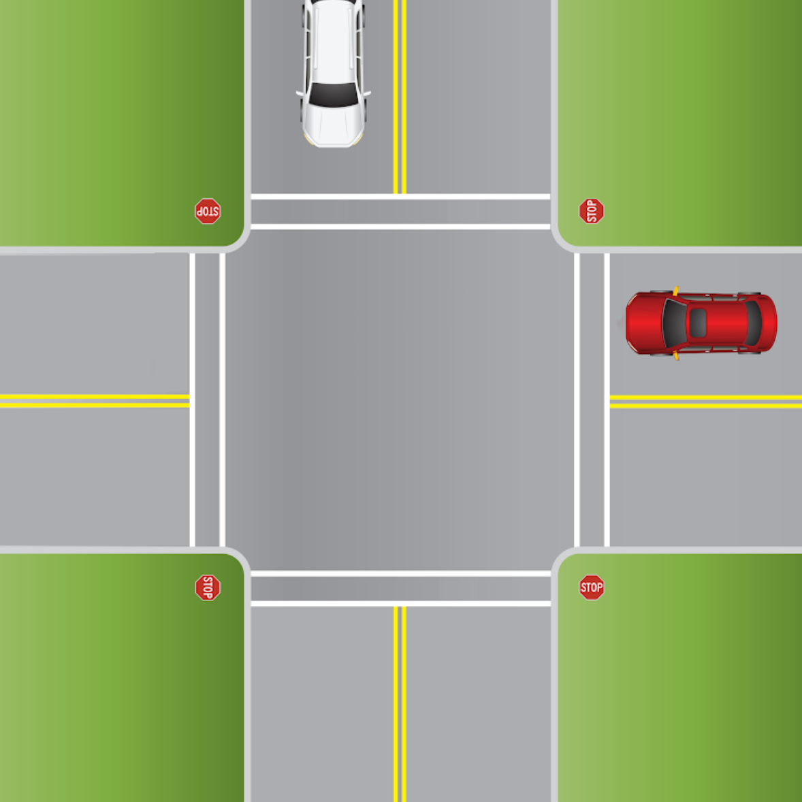
Project Organization
Predictable behavior
Versioning
Backups
How to build software/analysis pipeline

Slide 22
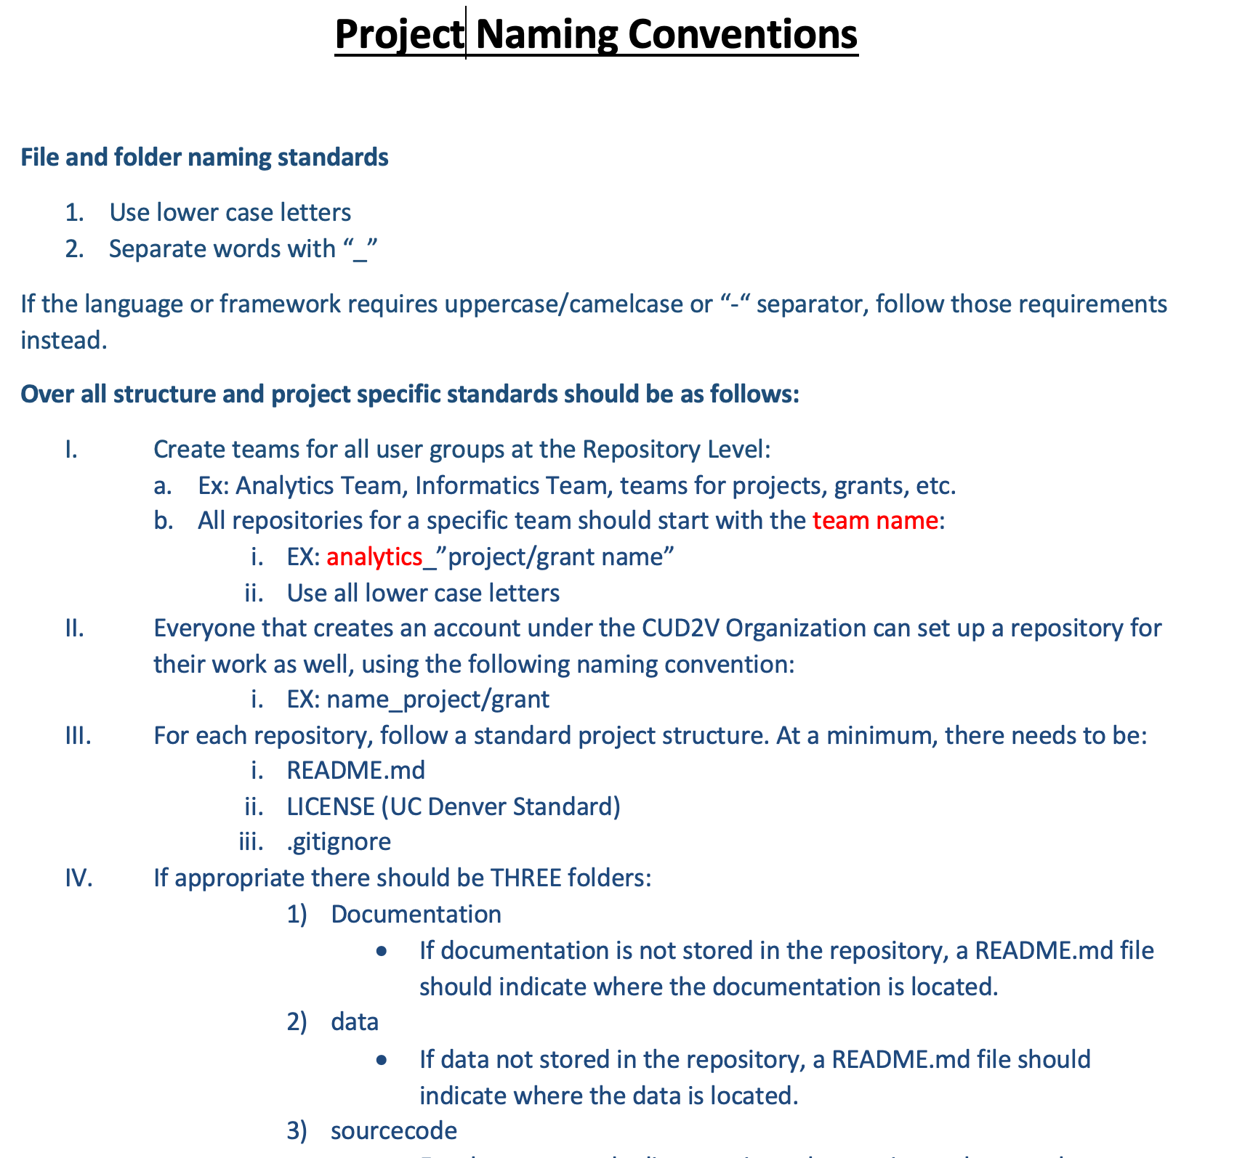

Slide 23
Backups
If it is important it should be backed up
If it took a non-trivial amount of work, it should be backed up
If it changes over time, it should be versioned
If it is generated by software, it should NOT be backed up
If you are not sure, back it up

Slide 24


Literate Programming
>
>
Notes:
Humans plus computers are able to accomplish more than humans working alone. Early computer software and operating systems focused on what works well for the computer. However in the 1980s some began to turn that paradigm around and think about what would work best for humans and allow them to do their best work in conjunction with computers.
Literate programming is a programming paradigm introduced in 1984 by Donald Knuth in which a computer program is given as an explanation of its logic in a natural language, such as English, interspersed (embedded) with snippets of macros and traditional source code, from which compilable source code can be generated.[1]
The literate programming paradigm, as conceived by Donald Knuth, represents a move away from writing computer programs in the manner and order imposed by the computer, and instead gives programmers macros to develop programs in the order demanded by the logic and flow of their thoughts.[4] Literate programs are written as an exposition of logic in more natural language in which macros are used to hide abstractions and traditional source code, more like the text of an essay.
Literate programming (LP) tools are used to obtain two representations from a source file: one understandable by a compiler or interpreter, the "tangled" code, and another for viewing as formatted documentation, which is said to be "woven" from the literate source.[5] While the first generation of literate programming tools were computer language-specific, the later ones are language-agnostic and exist beyond the individual programming languages.

Slide 25
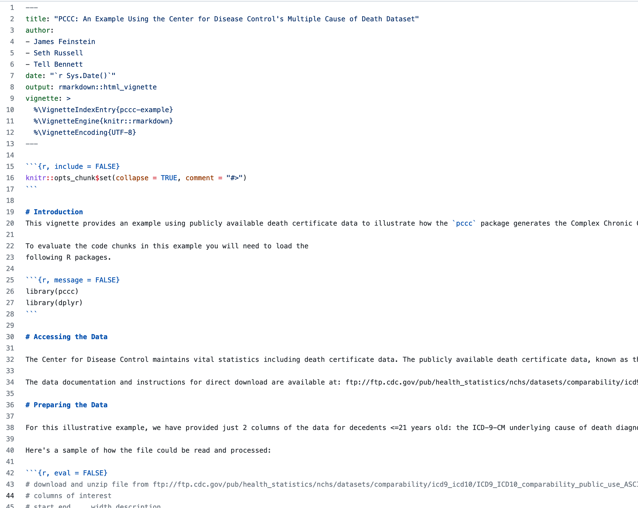
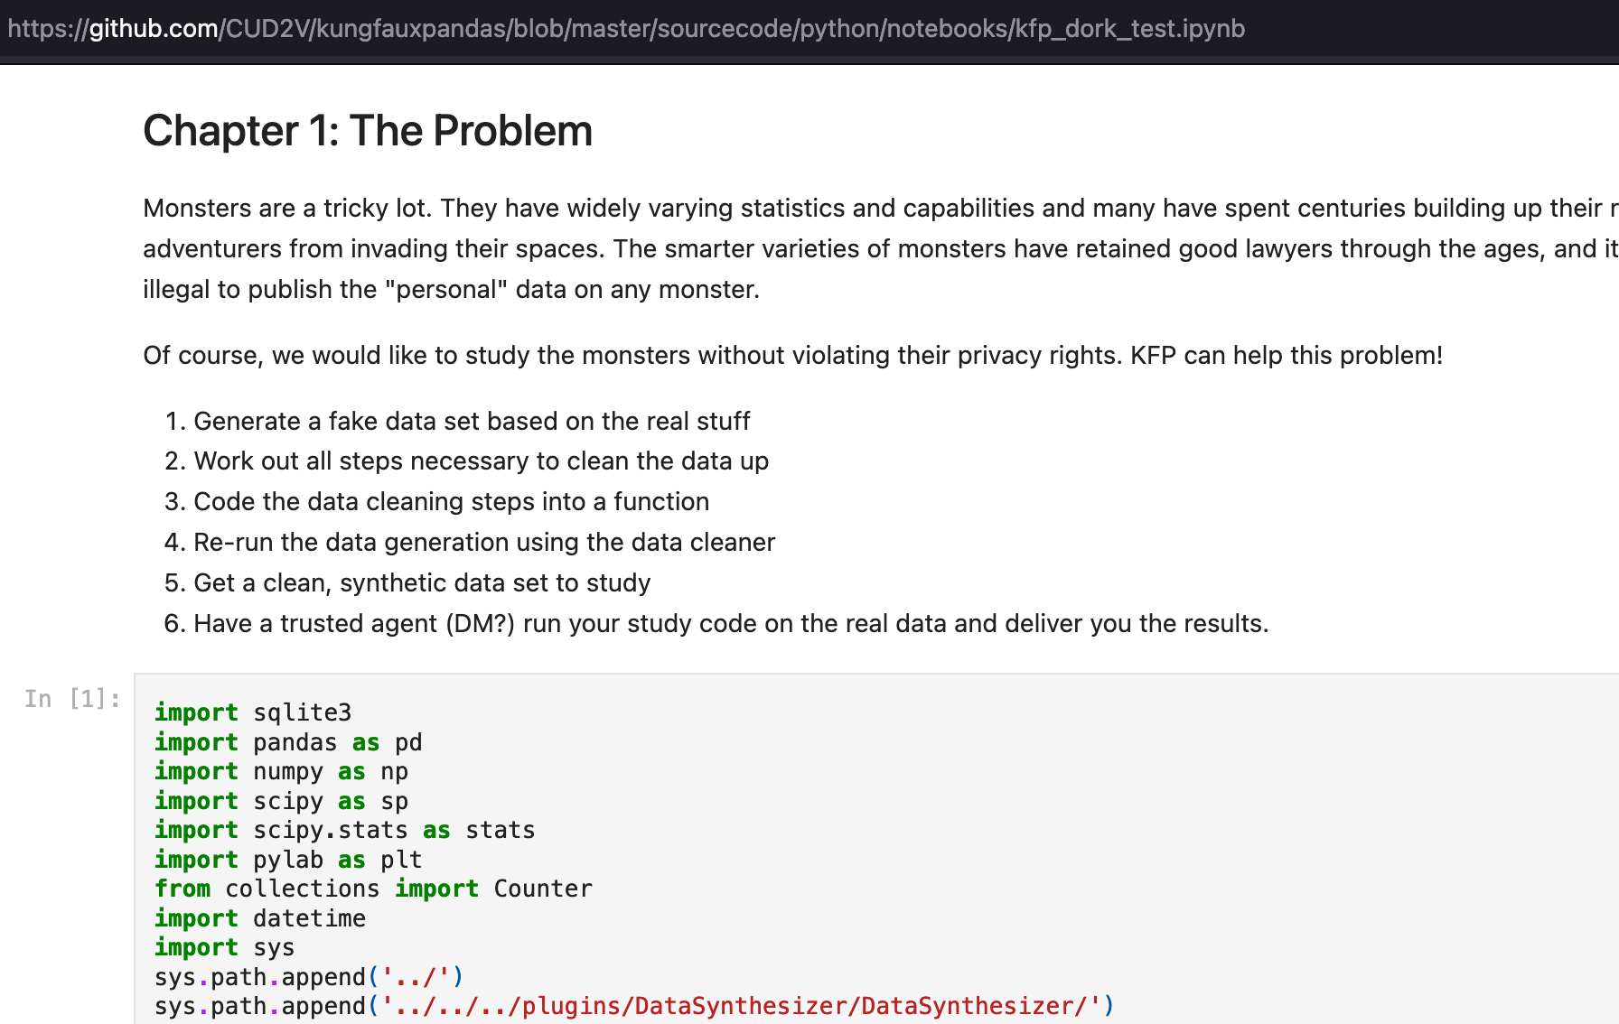
Literate Programming
R Markdown
Jupyter

Slide 26
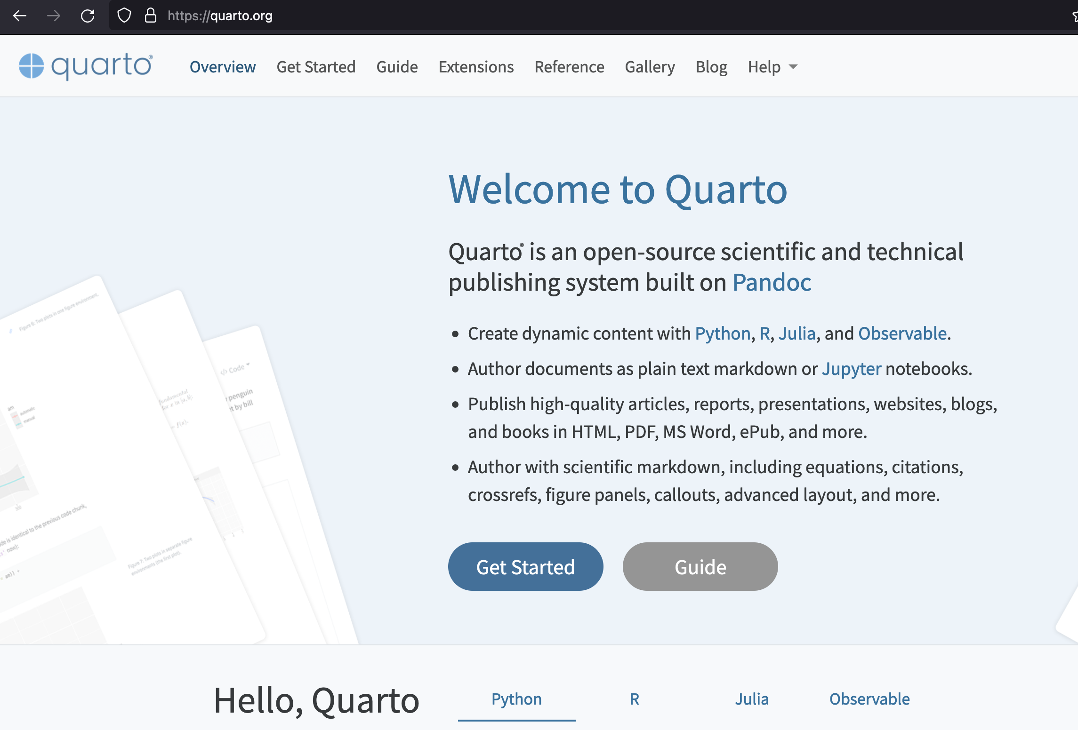
Literate Programming
Quarto
https://www.rstudio.com/conference/2022/talks/literate-programming-quarto/

Slide 27
Meta Programming
Programs that write programs
Programs that run programs

Slide 28
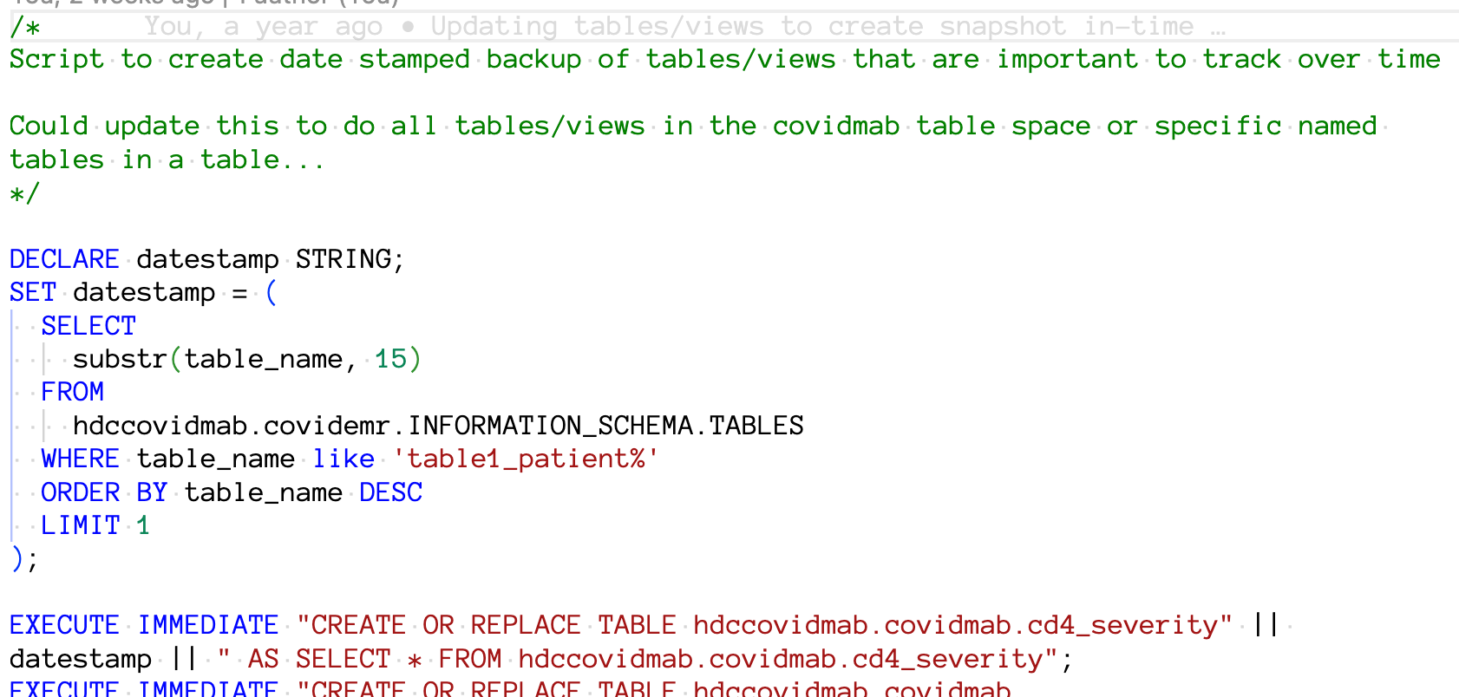
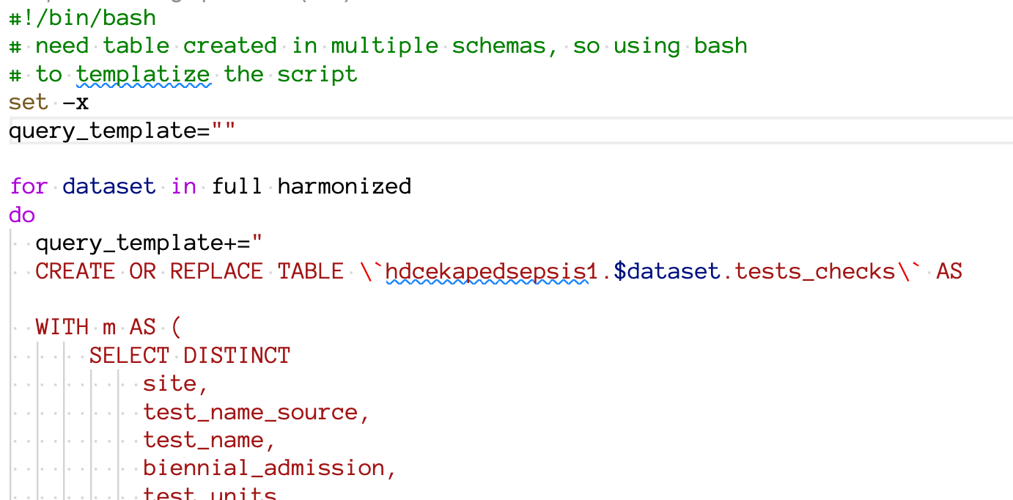
Programs that write programs
SQL that writes SQL
Bash that writes SQL

Slide 29
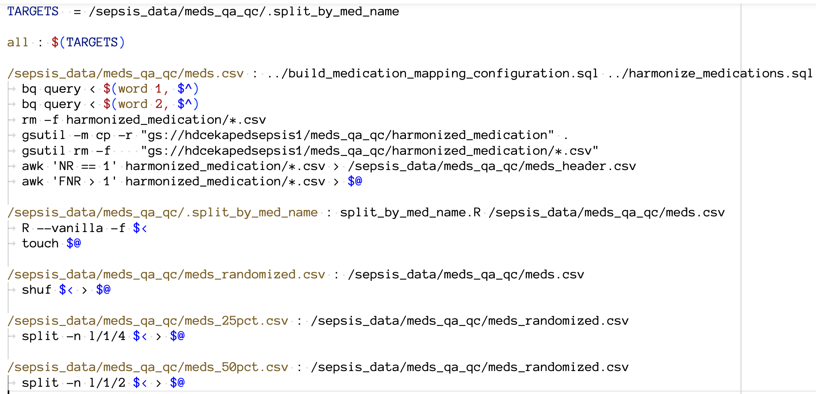
Programs that run programs
Make
https://www.gnu.org/software/make/
Notes:
Make has been around since the mid 1970s as a tool for compiling software on Unix like operating systems. Although it originally was primarily used for building and linking binaries, it has the capability to be part of a computational research pipeline to analyze data. Although originally focused on C, other languages such as R have adopted the use of Make.
This example is from a project Peter and I are working on. It retrieves data from a relational database and builds a dataset for use with R Shiny.
Other languages have build specific tooling – for example Java has Maven, Gradle, and Ant (though Maven and Gradle have largely replaced Ant)
Depending on your needs, bash or other native OS specific scripting tools can also be used to run your pipeline.

Slide 30
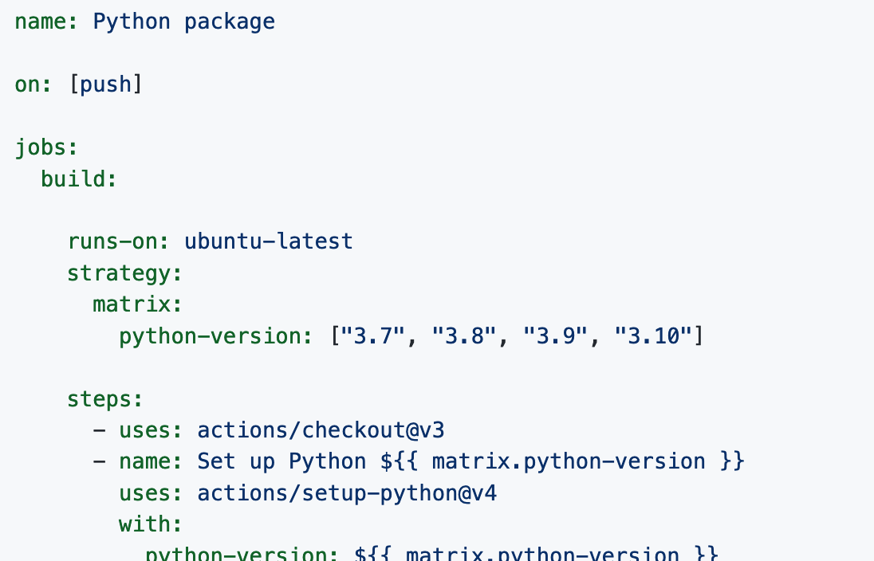
Programs that run programs
Continuous Integration – Github Actions
https://docs.github.com/en/actions

Slide 31
Status check
Close your browser window first if you still have it open
https://cups.fast.ai/computationalhusbandry
Notes:
https://cups.fast.ai/computationalhusbandry/teacher

Slide 32
Software Testing
It is a capital mistake to theorise before one has data. Insensibly one begins to twist facts to suit theories, instead of theories to suit facts.
A Scandal in Bohemia
Sir Arthur Conan Doyle

Slide 33
Software Testing – What to test
Identify the most important or unique feature(s) of software being implemented. Software bugs are found to follow a Pareto or Zipfian distribution.
Test data and software configuration.
If performance is a key feature, build tests to evaluate performance.
https://www.crn.com/news/security/18821726/microsofts-ceo-80-20-rule-applies-to-bugs-not-just-features.htm

Slide 34
Software Testing – How to test
Software developer develops unit tests.
Intended user of software should perform validation/acceptance tests.
Run all tests regularly.
Review key algorithms with domain experts.

Slide 35
Software Testing – Antipatterns
Interdependent tests — When a failure in an early test case breaks a later test, it can cause difficulty in resolution and remediation.
Testing application performance — Creating an automated test to perform this is difficult and does not carry over well from one machine to another.
Slow running tests— As much as possible, tests should be automated but still run quickly. If tests are slow they will not be used.
Only test correct input—A common problem in testing is to only validate expected inputs and desired behavior. Make sure tests cover invalid input, exceptions, and similar items.

Slide 36
Computational Husbandry questions?
Seth Russell – seth.russell@cuanschutz.edu
Peter DeWitt – peter.dewitt@cuanschutz.edu
SOM, Dept of Biomedical Informatics
Presentations: https://github.com/magic-lantern/Computational-Husbandry-2022
Survey: https://forms.gle/ZumeuAiWRm83ra9h9

